Slide 1


P33 Project: Spending Dashboard
CREDITS: JOHN, JOSEPH, DONGMIN, JOAQUIN, RUTAM, MUHAMMAD

Slide 2


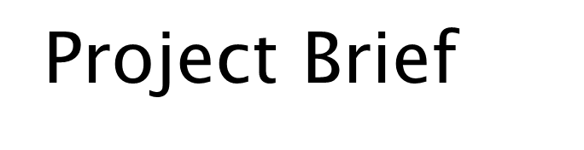
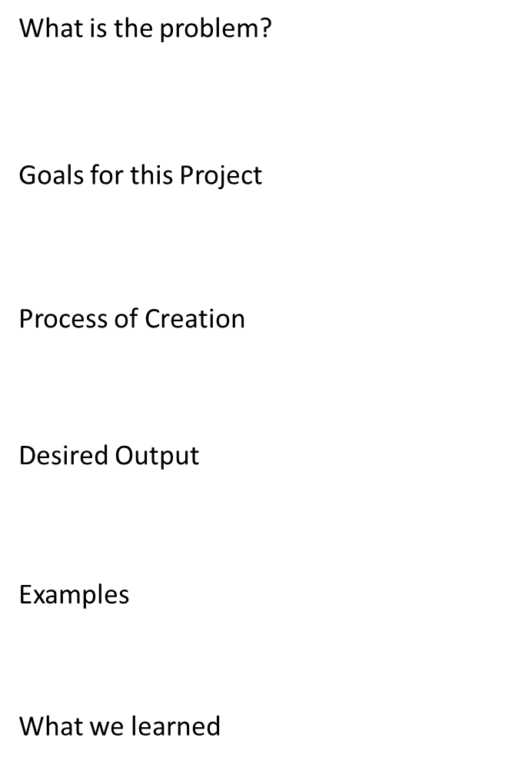





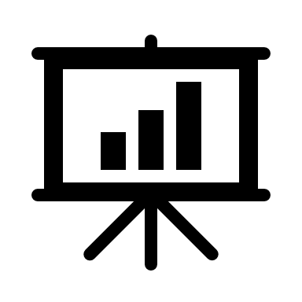


API
GUI

Slide 3
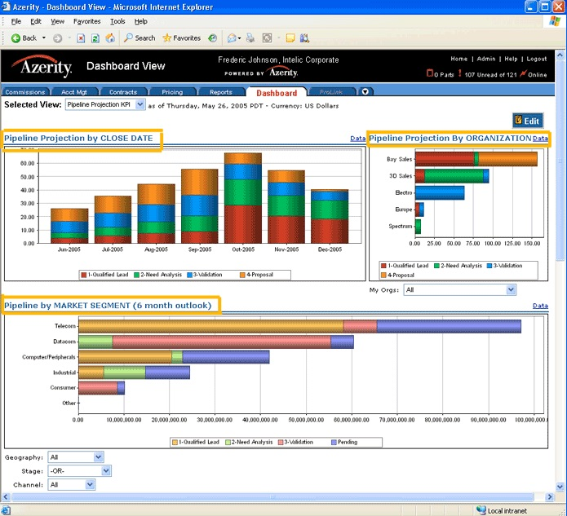
What is the problem?
Many users lack a good and easy-to-use application that helps them with their money management.
Often, common banking apps have hard to interpret data or irrelevant information that is overwhelming for consumers.
This Photo by Unknown author is licensed under CC BY.

Slide 4


Goal for this Project
Our goal for this project is to create a dashboard in which it will display the recent transactions, cards you own, your spending health, income, total balance, savings, a pie chart showing percentages of how much you spent and where, and a line graph depicting your spending amounts overtime.
We hope to achieve a dashboard that has a unique and very understandable display, an easy-to-use UI, and an API that will be able to help manage your spending habits by giving advice based on the given information shared with the system.

Slide 5

Process of Creation
The first step we took into making this unique dashboard was to create a wireframe. We used this wireframe in order to outline what will need to be created. It helps on the coding portion of the project because it gives us a base of understanding on what will need to be coded in.
We created APIs (application programming interfaces) which help us visualize what the code will look like for the finished product.
The Swagger Application was used to give the program a visual interface to test it out at the developers end.

Slide 6
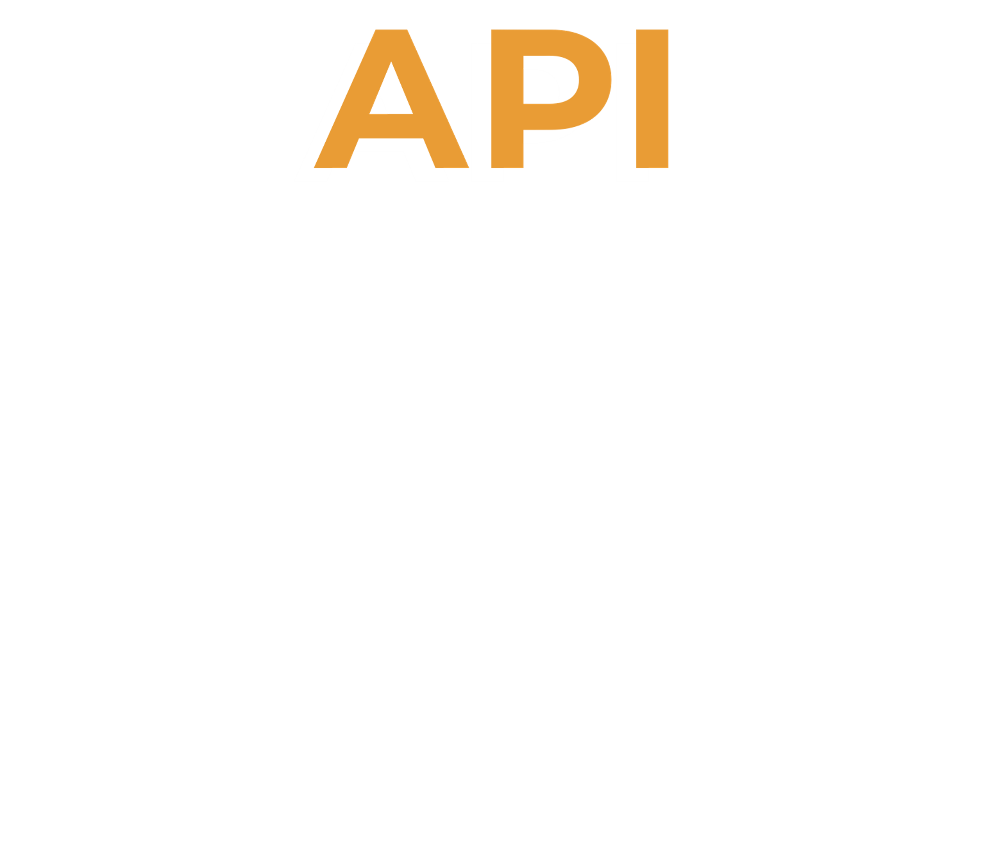

Slide 7
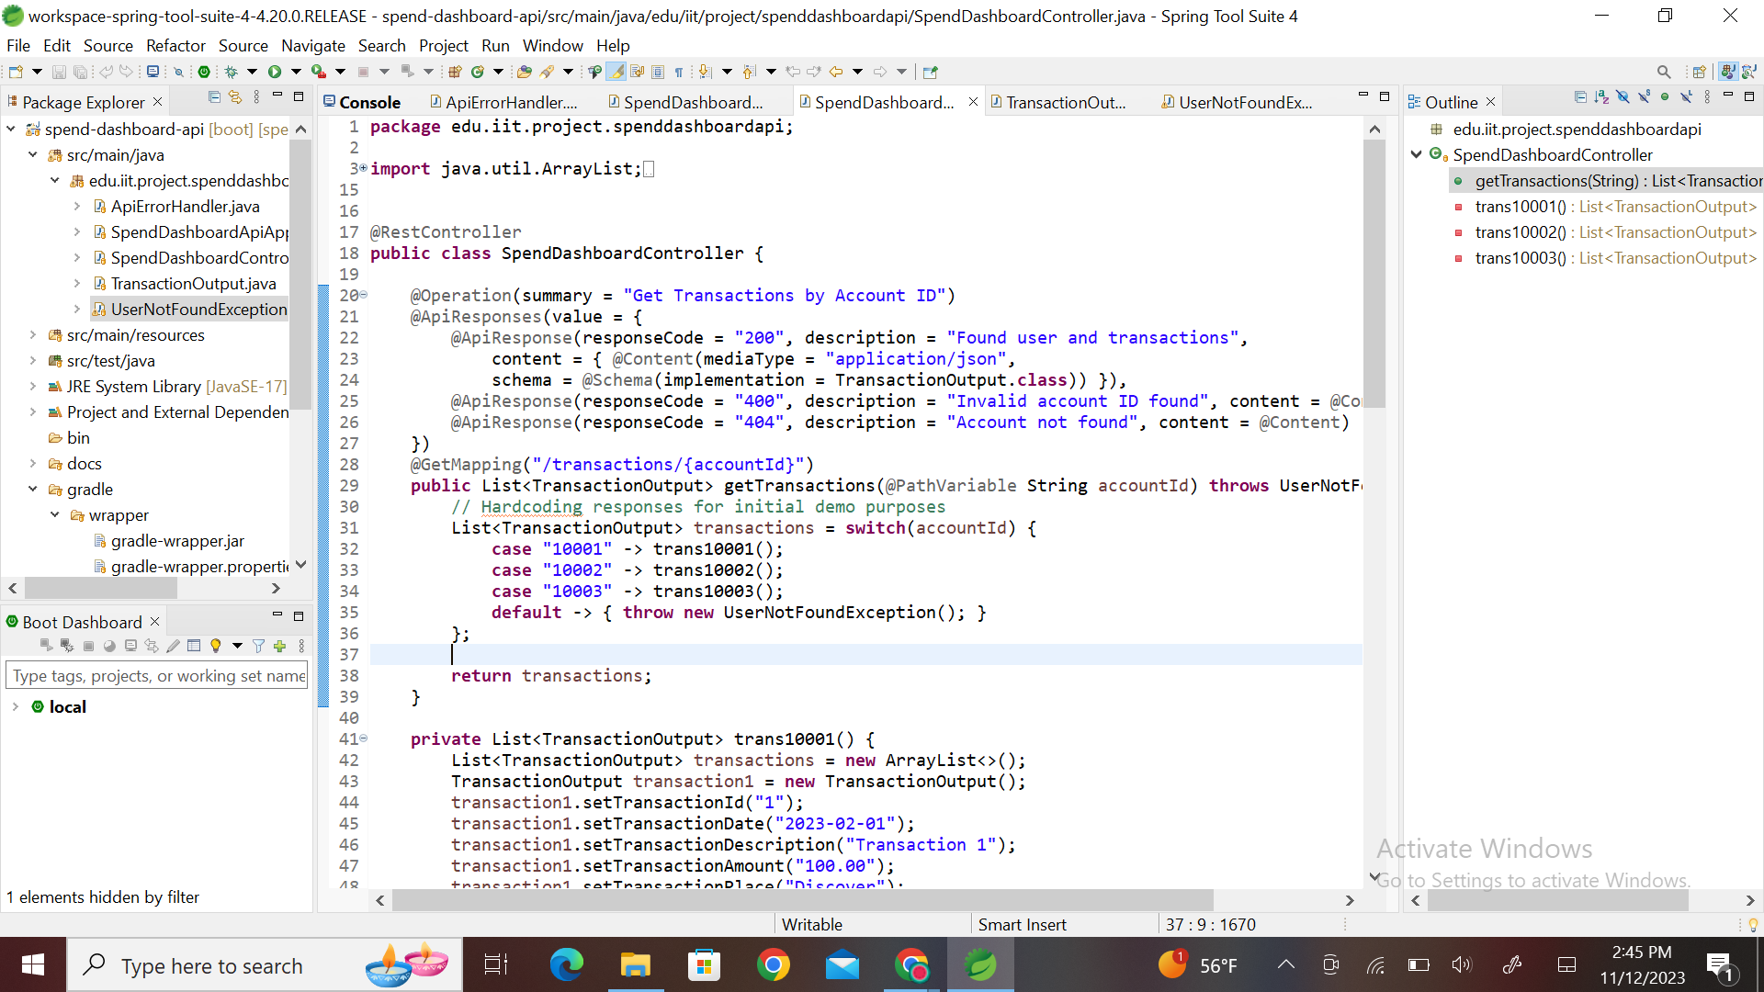


Java is the main programming language used for this project.
The API was written in Spring Tool Suite which served as the IDE.
The API takes an input, processes the information and then displays the output.

Slide 8


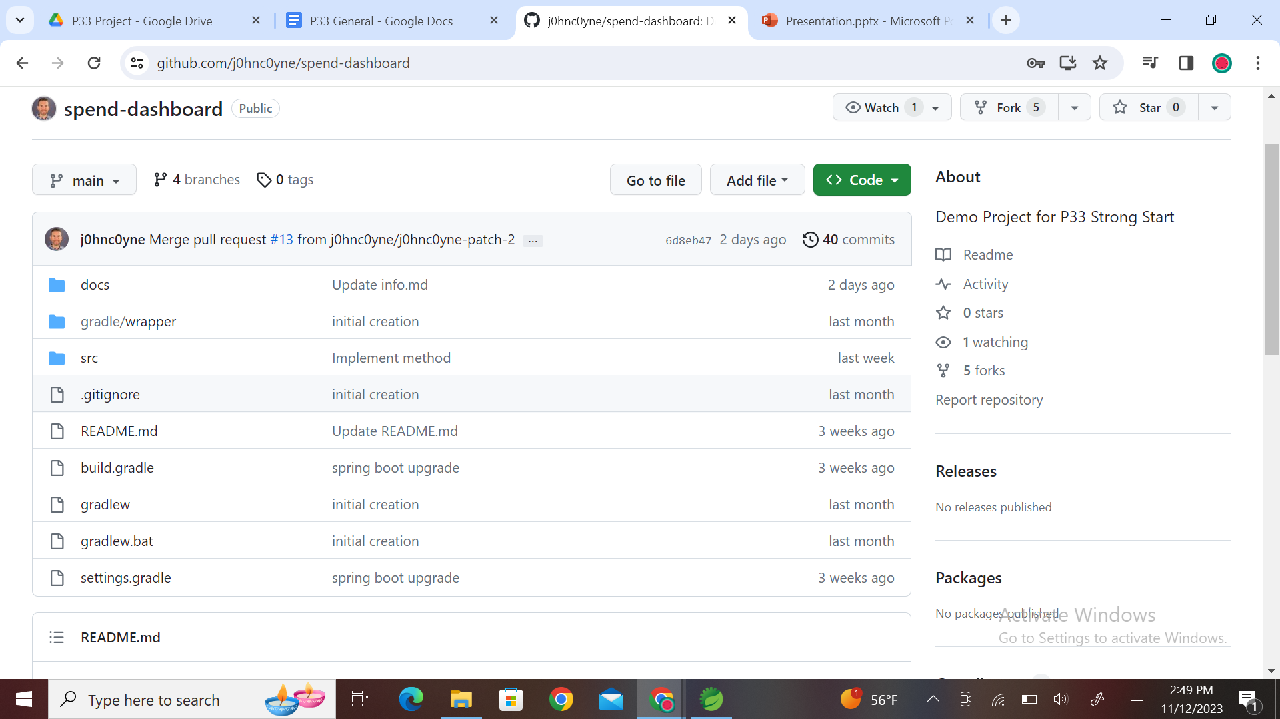
Our main program was designed with the help of our Mentor John Coyne.
We Created a main directory "Spend Dashboard" which had all the files for the project including the API.

Slide 9

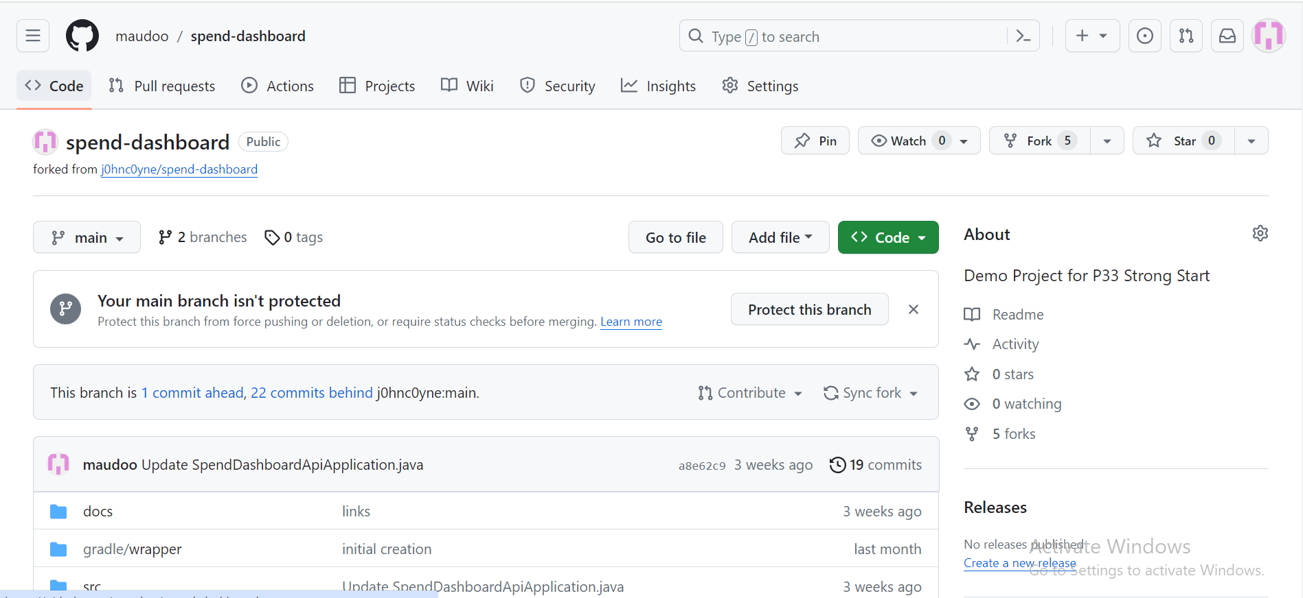
FORK
A fork clones the entire repository and allows multiple users to work on the same code without changing the main code.
After making the final changes to the code we commit the code to the main program and create a pull request so that the owner merges it to the main code after reviewing it.

Slide 10
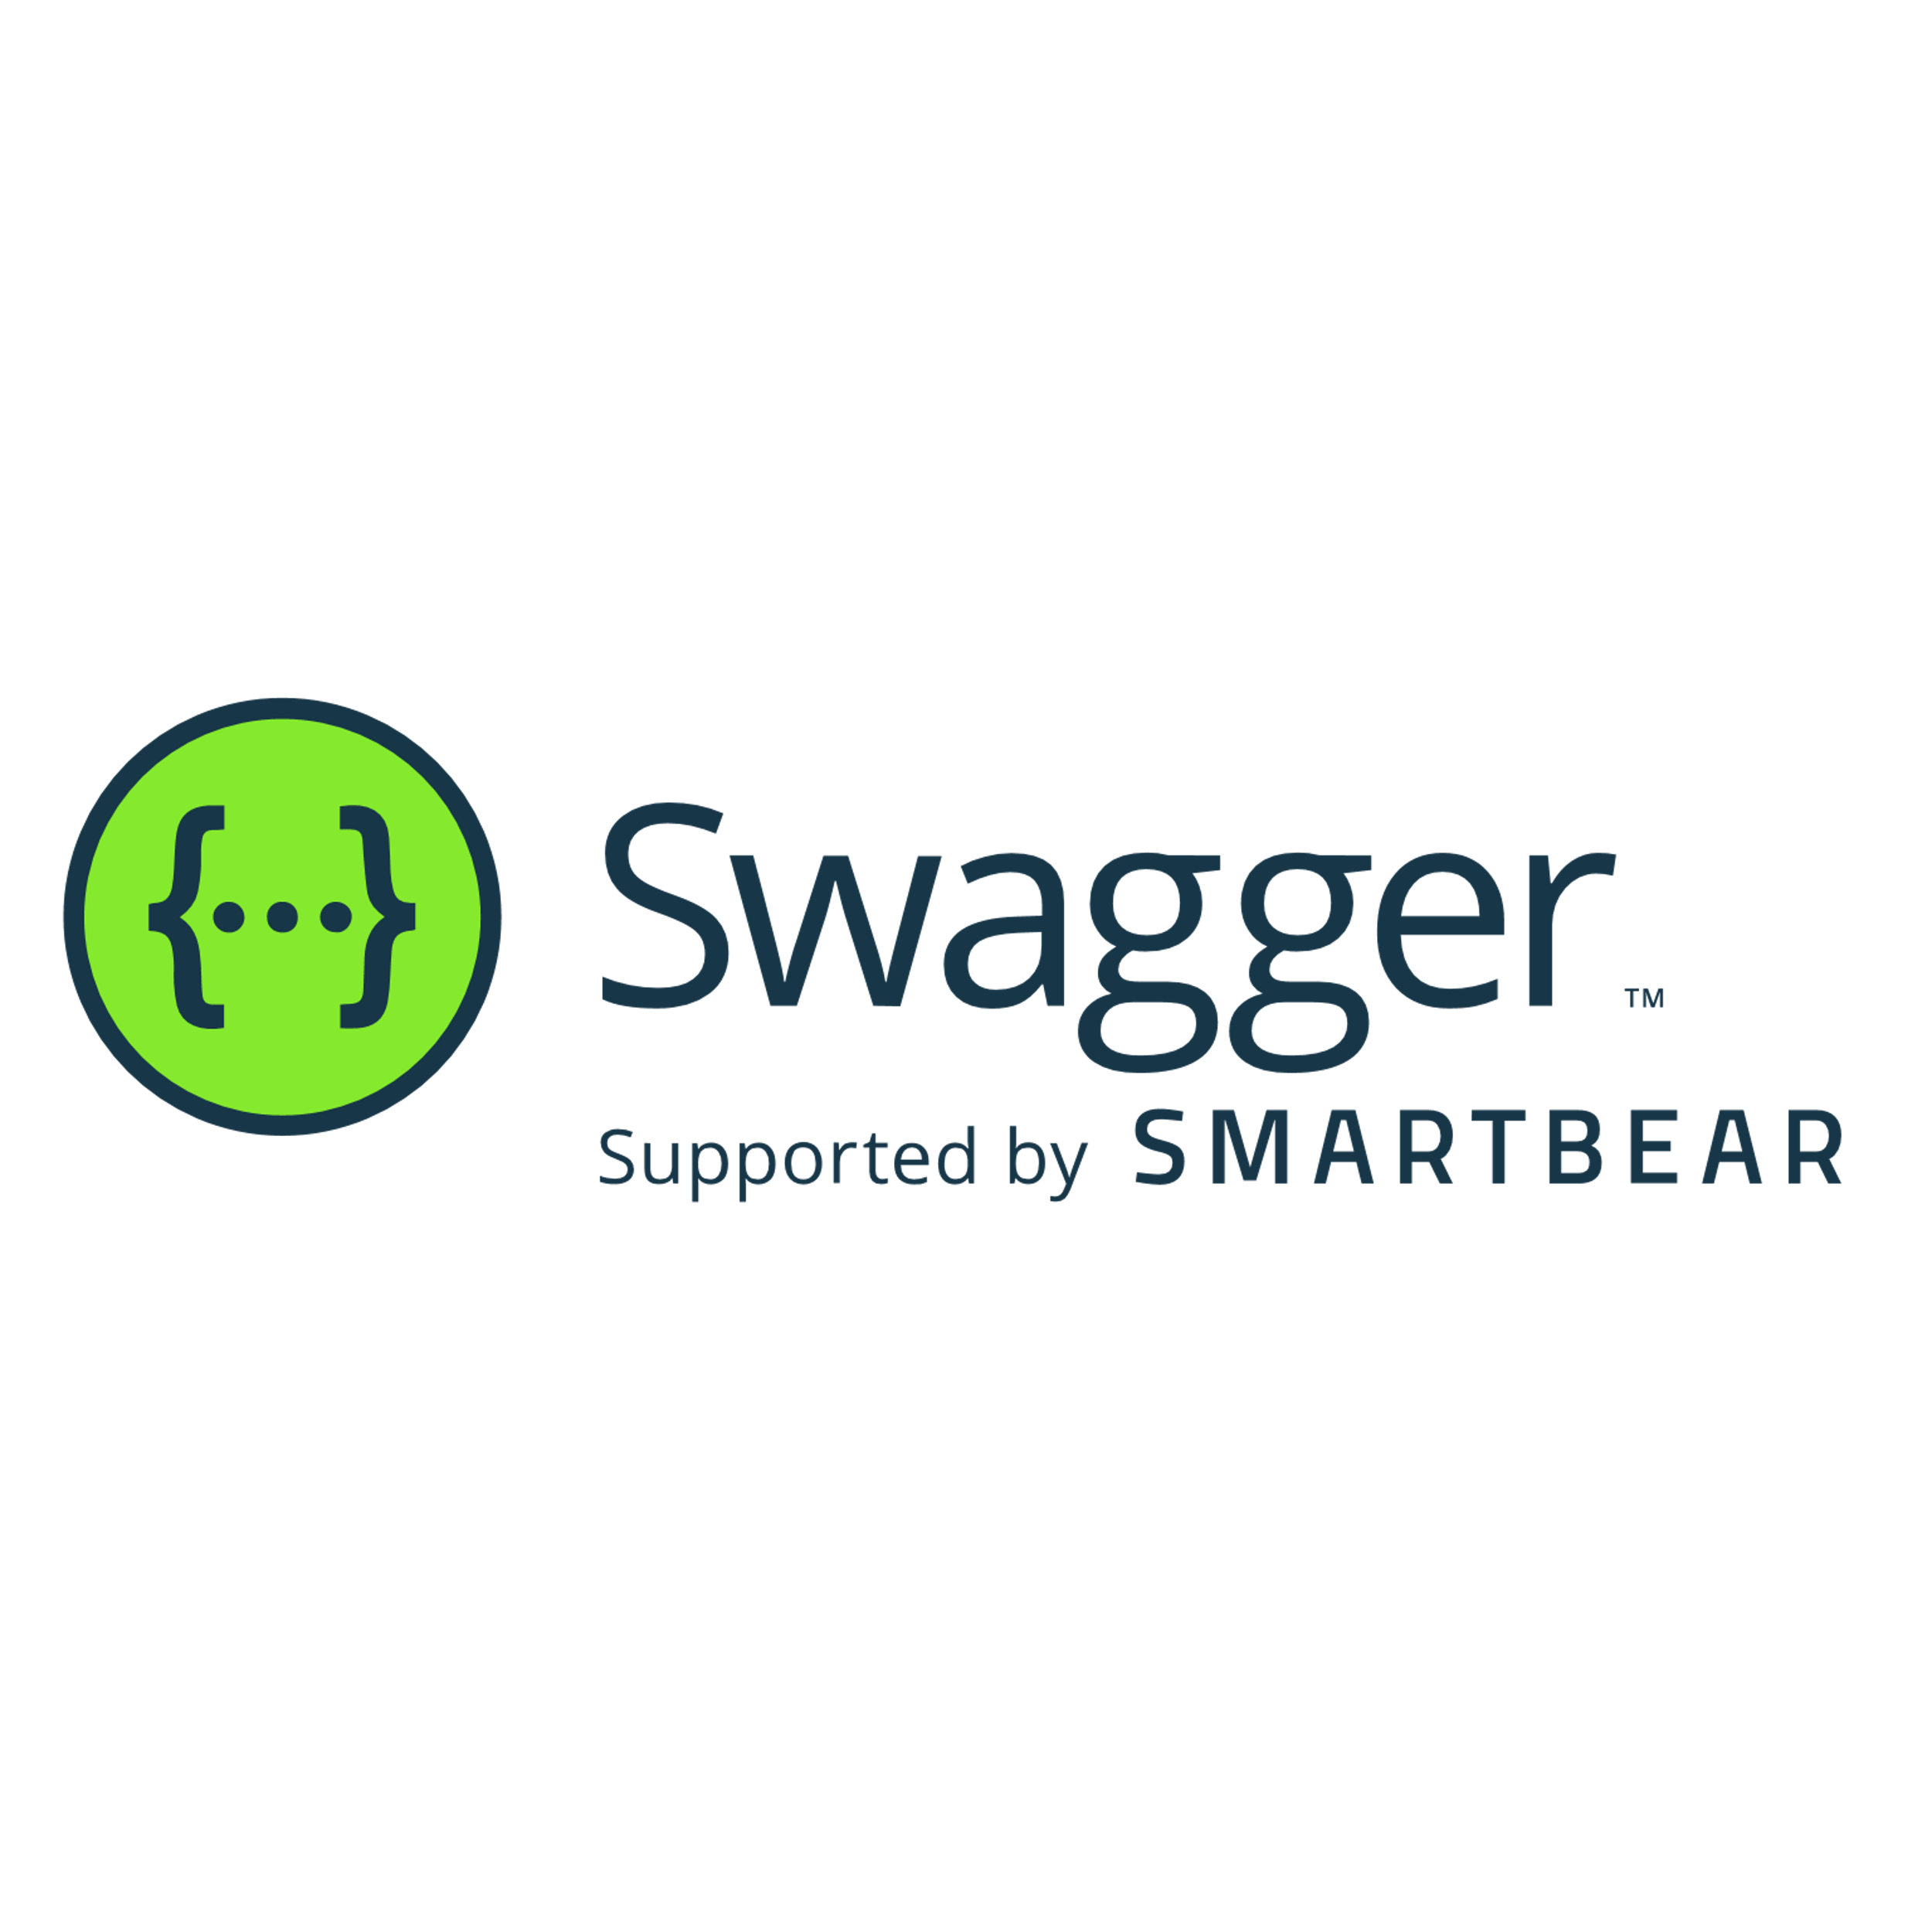
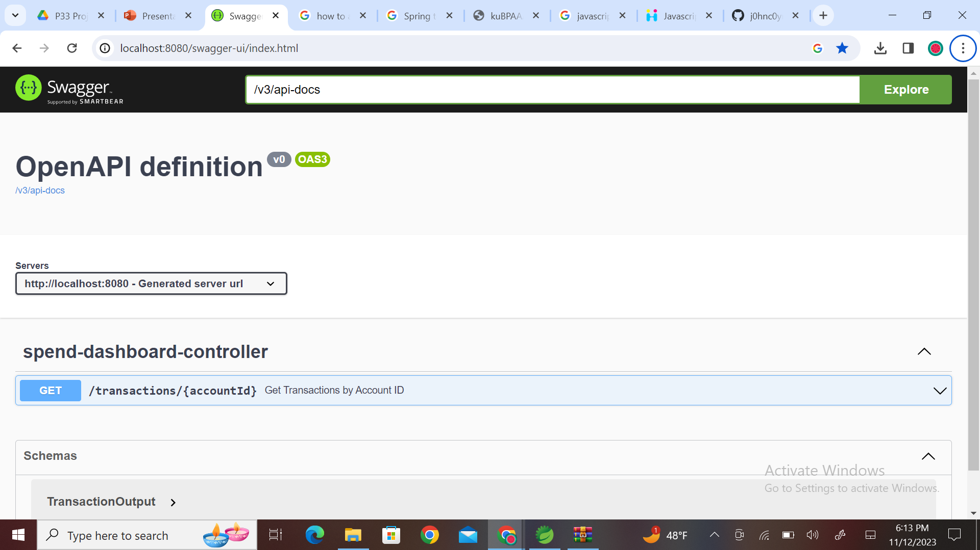
Swagger allows you to describe the structure of your APIs so that machines can read them.
We used Swagger to build a visual interface. This allows the developer to test the API and remove any possible bugs.

Slide 11
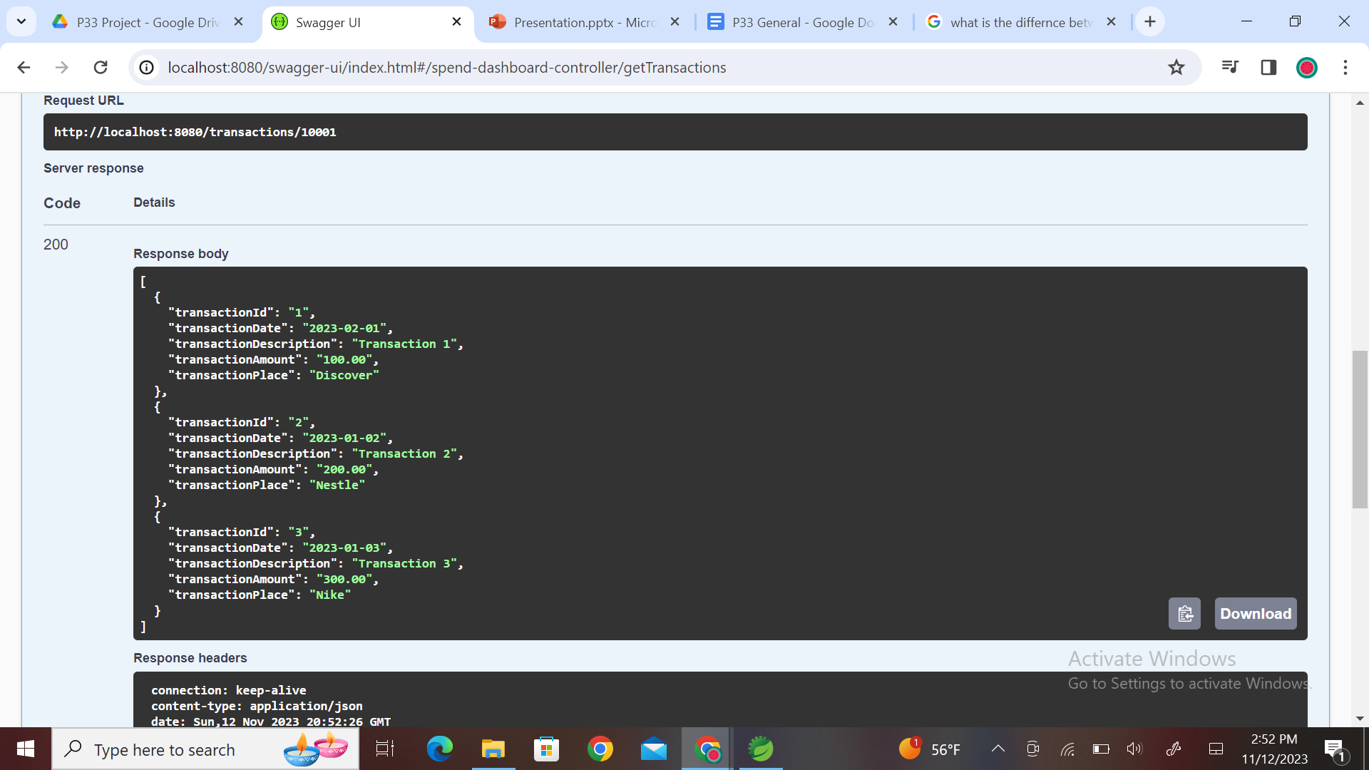
Here is glimpse of a simple test case for swagger in its developing stages.
It runs on a browser and does not need a special application to run it.
For example, You give the API an account ID and it returns you a set of descriptions.

Slide 12


Slide 13
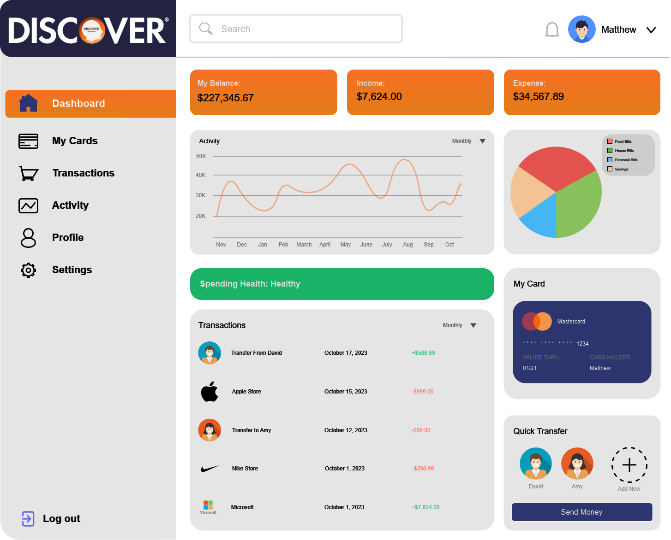
Desired Output
This is an example of what the final output of the project will look like
We plan to make the dashboard as visually appealing as we can to add readability to the dashboard. It is very easily understandable and will allow the user to move around the UI without facing any issues or facing confusion on where something is at.

Slide 14
The Charts
The charts will represent how much money you spend and where. The line graph indicates how much you spend over time and how much throughout the year. This can be changed to different time frames. The pie chart depicts categories of where you spend your money and how much you spend in that category. These graphs are to help you build an understanding of how much you spend, where that money goes, and how much you spend at a given time frame.

Slide 15
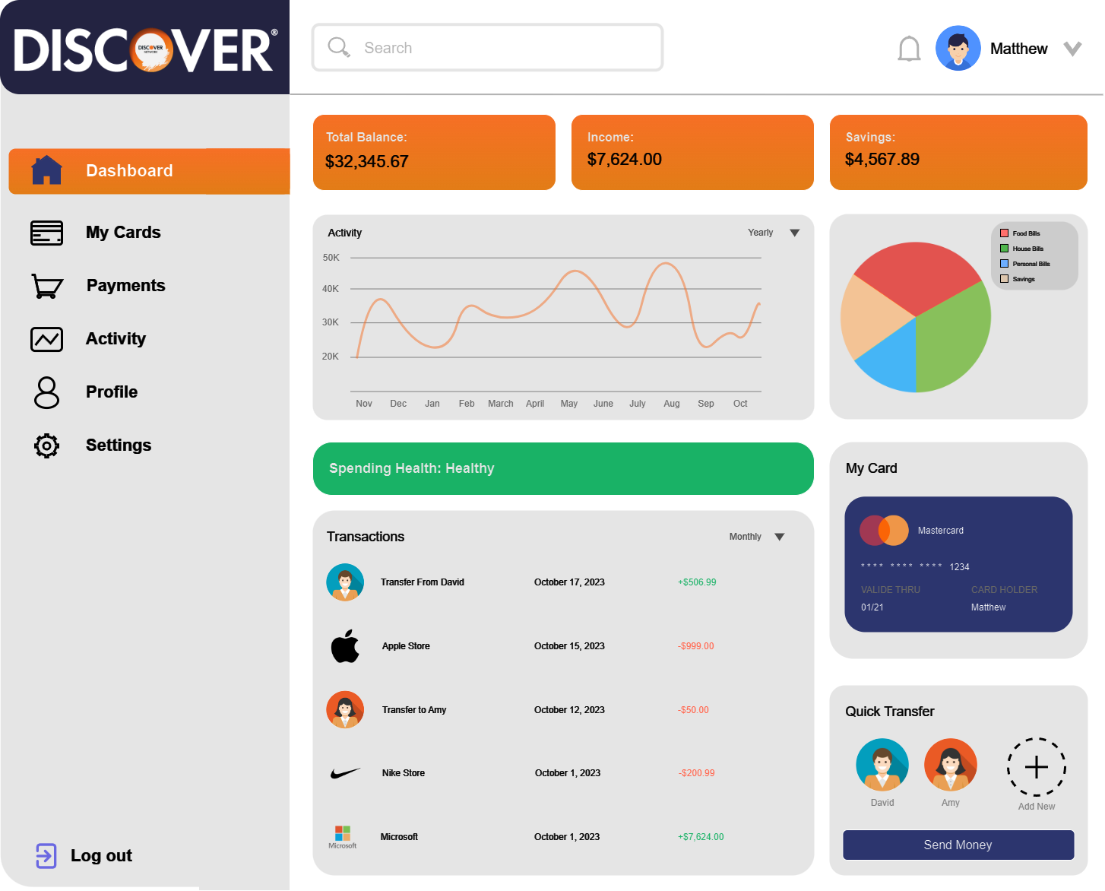
Spending Health and Transaction History
The Spending Health displays a state of how much you spend compared to how much you make. If you spend little based on your income, then it represents “Healthy,” (Green) If you spend around half on your income yearly, it will indicate ”Fair,” (Yellow) and if you spend more than 60% of your income yearly, the it will display “Poor” (Red)
Transaction History portrays all the most recent transactions you have had. It includes how much you spent/received, where it was spent/received, and when the transaction happened. Recent transaction history can be changed to a certain category if a different category is selected, displaying only those most recent transactions in the given category.

Slide 16
Card Management
Based on the card selected, transaction history, spending health, and the graphs will be changed
Those categories of the dashboard will be changed based on what card is currently selected
You can add/remove cards if you would like to

Slide 17
Friends/Quick Transfer
This feature allows the user to connect other members of the dashboard to their dashboard in order to allow them to participate in what we call Quick Transfer
It allows the user to quickly send other users money if that user owes them money
It is much simpler to use than other banking/money transferring applications out there. This transaction will also appear in the transaction history

Slide 18
Money Management
The first and most important part of this dashboard will be a display of different money managements
My Balance keeps track of how much money you have in your card.
Income indicates the amount you add to Total Balance each month.
Expense is the amount of money you have spent during a set amount time. This number changes depending on the activity graph.

Slide 19
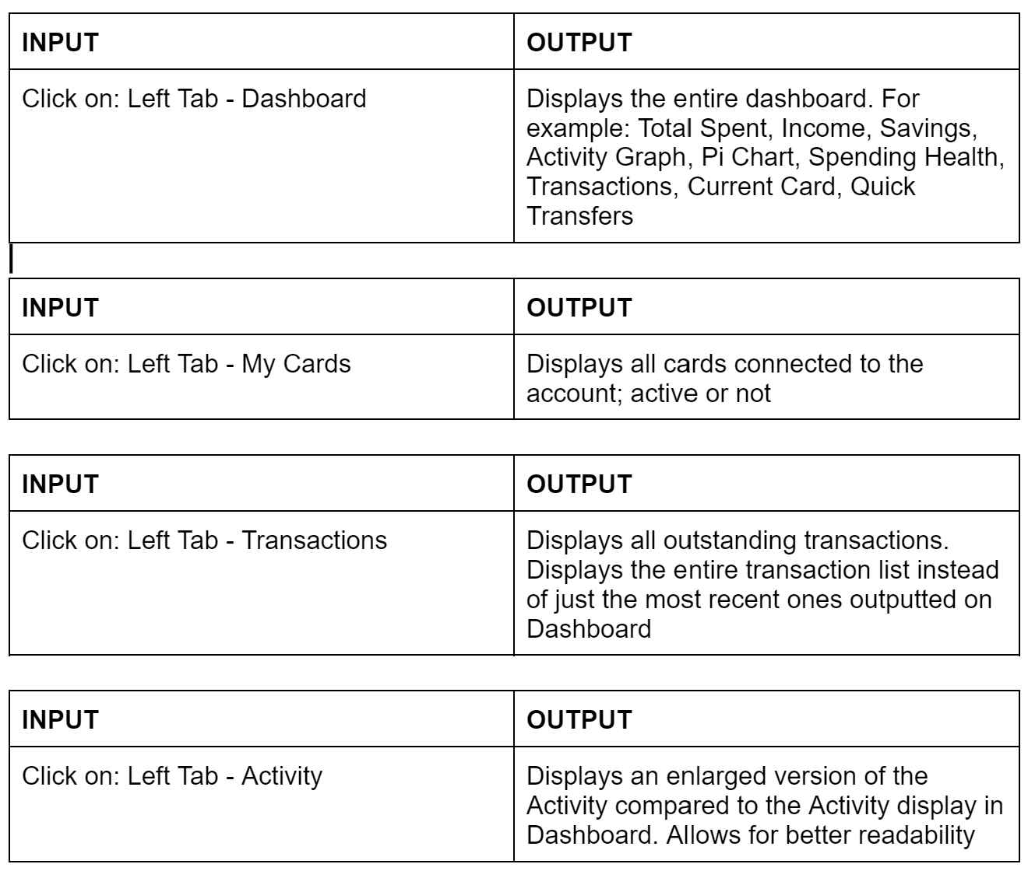
Test Cases

Slide 20
Things We've Learned
How to use GitHub: Pull requests and Merging
How to use a wireframe: Giving us a base of understanding of how the coding will be done to reach the desired output.
How to use Swagger, a visual interface for developers to use and test their APIs for any major bugs or glitches.

Slide 21
Things We've Learned
Dividing work equally: Efficient work flow and decrease of stress
Team dynamics incorporated – Plan of motion and assigning of roles
Things we would do differently on a future project – More organization, working ahead on schedule and making roles more obvious amongst the group.

Slide 22
Thank You For Listening!

